Slide 1
Mach-Zehnder Interferometer for 2-D GRIN Profile Measurement
Instrument Overview
Sample Preparation
Measurement Uncertainty
University of Rochester
Gradient-Index Research Group

Slide 2
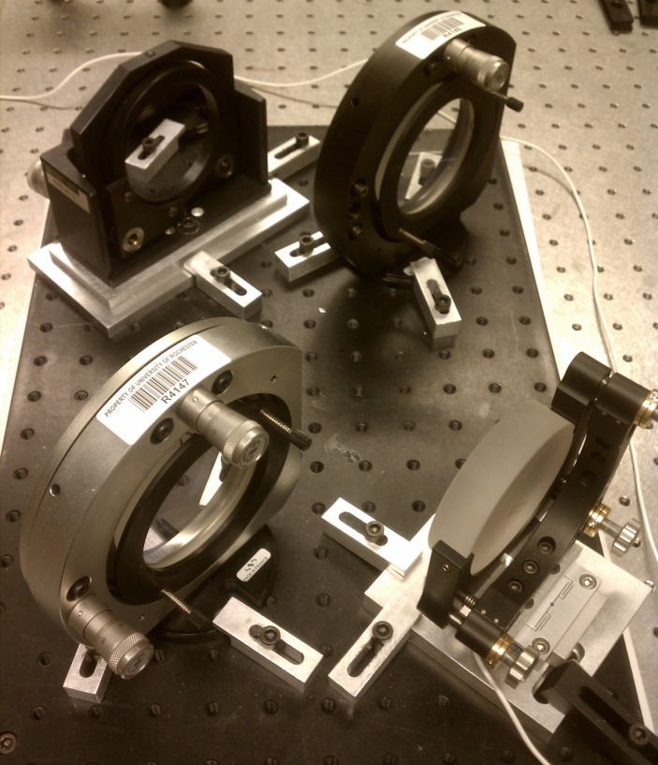
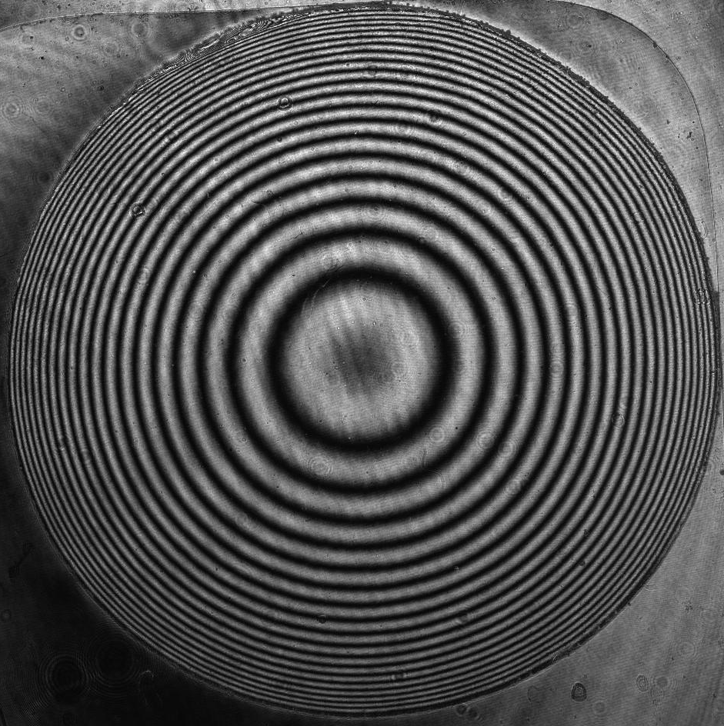
2D GRIN Measurement: Mach-Zehnder Interferometer
Laser
Wavelength range covered
0.355 – 1.064μm, 1.55 – 4.6μm, 8 – 12μm
Measurement accuracy
δ(Δn) = 1E-5
Beam size: 65mm x 40mm ellipse
Sample prep requirements
Thin (~1mm), plane, parallel sample with GRIN “exposed” (index is constant through sample thickness)
Spatial Filter
Mirror
Beam Splitter
Beam Splitter
Sample
Mirror
Lens
Measure: φ, t
Calculate: Δn
Detector
Measurement Slice
Measured Interferogram
GRIN Blank

Slide 3
Mach-Zehnder Sample Prep
Measurement Slice
Measured Interferogram
GRIN Blank
Radial
Sample thickness chosen so that # of fringes can be resolved by imaging optics and detector
Surface figure error and wedge lead to measurement error
y
x
Axial
Thin slice cross-section that “exposes” the gradient for measurement
Index should be constant through the thickness of the sample (z-axis)

Slide 4
Mach-Zehnder Measurement Uncertainty
m = # of fringes
λ = wavelength
t = thickness
Best-case uncertainty is determined by a root-sum-square of the terms in the Δn calculation
Uncertainty is increased further by surface figure error and wedge, but it can be minimized by measuring in an index matching fluid
Uncertainty due to: | Expression
- Figure error measured in air - Wedge error if no known homogeneous region
- Figure error measured in fluid
- Figure error measured in matched fluid (n_{fluid} = n_{samp} at some location in sample) - Wedge error if there is a known homogeneous region
Use the calculator on the next slide to determine the measurement error for your sample

Slide 5
Calculation of Measurement Uncertainty
Notes:
Interferometer accuracy is on the order of λ/50 (δm = 0.02)
Wavelength uncertainty is typically small and does not contribute much error
Best uncertainty is achieved by making the sample as thick as possible while maintaining the ability to resolve fringes (see next slide)

Slide 6
Calculation of Fringe Density
The fringe density limits the thickness of the sample
Thicker samples will eventually reach a fringe density that cannot be resolved
Use calculator below to estimate fringe density in your samples
m = # of fringes
λ = wavelength
t = thickness
Notes:
For wavelengths in the visible and NIR, the maximum fringe density that can be resolved by the interferometer is ≈100 mm⁻¹
Samples with large fringe density will require a smaller field of view
Stitching may be required to measure the full sample

